Slide 1
Topic 8a
More on Structure Charts

Slide 2
Structure Charts with Data Flow
A structure chart can show data flow into and out of a function
function1
Data in
Data out
function2

Slide 3
Structure Charts with Data Flow
main
main
rnum
radius
radius
area
display_rboxed
get_radius
compute_area

Slide 4
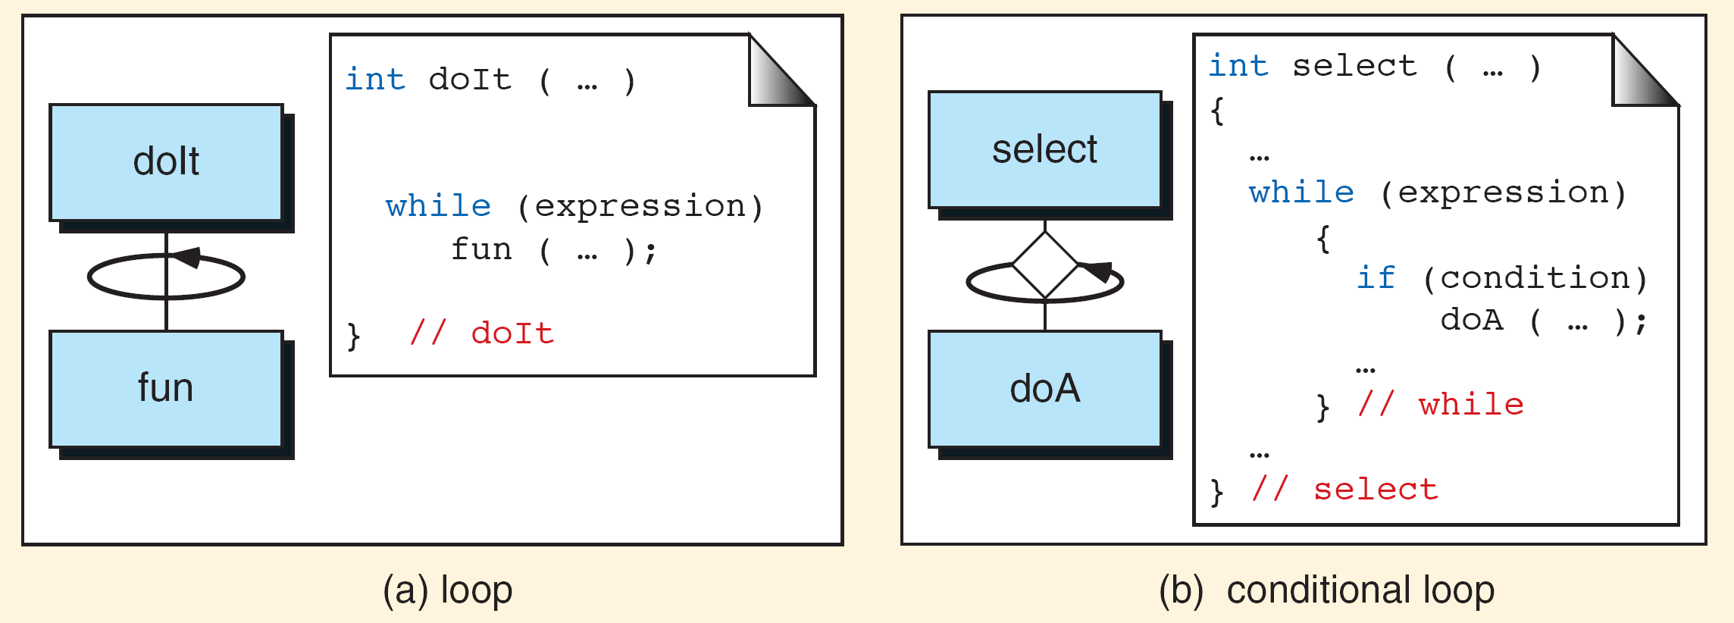
More Structure Chart Symbols
Loop

Slide 5
More Structure Chart Symbols
Conditional

Slide 6
More Structure Chart Symbols
Conditional Loop

Slide 7
More Structure Chart Symbols
Exclusive Or

Slide 8
Example Structure Chart

Slide 9
Example Structure Chart

